Slide 1

Global YouTube Trend Analysis
Data Analytics Project using Python
- Muskan Verma

Slide 2
Tools & Technologies
Python
Pandas
Matplotlib
Seaborn
Focus Areas
Audience Engagement Analysis
Creator Growth Trends
Geographic Distribution

Slide 3
Project Objective
The objective of this analysis is to examine global YouTube channel statistics and identify the key factors influencing channel growth, audience engagement, and monetization.
This project aims to:
Analyze subscriber and viewership patterns across channel categories
Evaluate country-wise distribution of top YouTube creators
Identify relationships between subscribers, uploads, views, and earnings
Understand audience preference trends through visualization
Generate data-driven insights from creator performance metrics

Slide 4
Dataset Overview
Key Variables Analyzed
Subscribers
Video Views
Channel Category
Country
Dataset Attribute | Description
Total Records | 1006 YouTube Channels
Total Features | 29 Variables
Data Type | Structured CSV Dataset
Domain | Media & Technology

Slide 5
Data Cleaning & Preprocessing
Cleaning Steps Performed
Identified and handled missing values in:
Country
Category
Subscribers for last 30 days
Video views for last 30 days
Checked and removed duplicate records
Verified data types and feature consistency

Slide 6
Exploratory Data Analysis
Objective of EDA
To transform raw data into interpretable insights supporting creator economy analysis.
Analytical Areas Explored
Distribution of subscribers and video views across channels
Country-wise concentration of leading YouTube creators
Category-wise channel performance and audience reach
Relationship between subscribers, video views, and earnings

Slide 7
Data Visualisations
Correlation Heatmap
Subscriber Dominance Among Top YouTube Channels
Subscribers and Video Views Relationship
Country-wise Analysis
Distribution of Channel Creation Periods
Recent Viewership by Channel Type

Slide 8
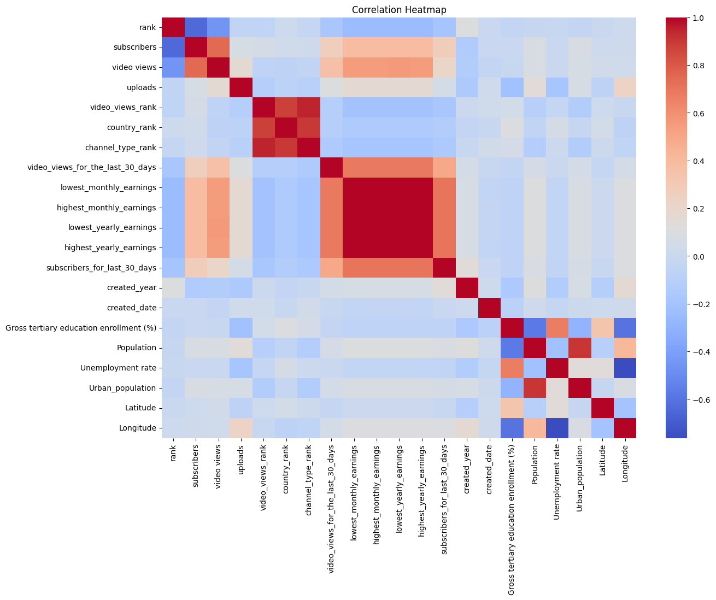
Correlation Analysis of YouTube Metrics
Video views show strong positive correlation with both subscriber count and channel earnings.
Video views in the last 30 days show a strong positive correlation (r ≈ 0.7) with recent subscriber growth and earnings.
Upload count has relatively weak correlation with subscribers and video views.

Slide 9
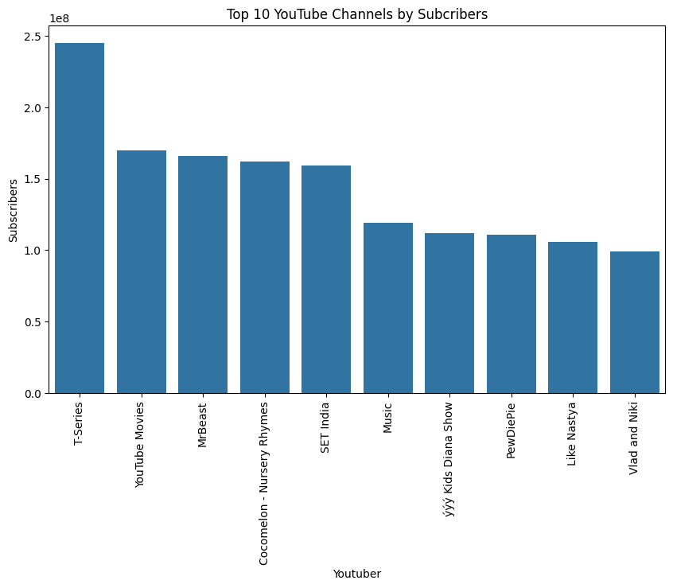
Subscriber Dominance Among Top YouTube Channels
T-Series leads the ranking with approximately 245 million subscribers, exceeding the second-ranked channel by nearly 75 million subscribers.
MrBeast ranks among major media brands, reflecting the strong influence of individual creators.
Music and entertainment-based channels occupy a majority of the top positions, reflecting strong global demand for entertainment-focused content.
Interpretation
The analysis highlights the dominance of entertainment-focused content in driving large-scale audience growth on YouTube.

Slide 10
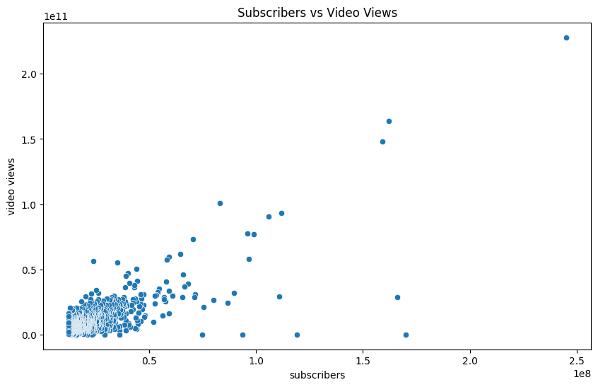
Subscribers and Video Views Relationship
A positive relationship exists between subscriber count and total video views.
Channels with larger subscriber bases generally achieve higher viewership.
Several channels exceed 100 billion total views, highlighting their exceptionally large audience reach.
Interpretation
Higher subscriber counts are generally associated with increased content visibility and audience engagement.

Slide 11
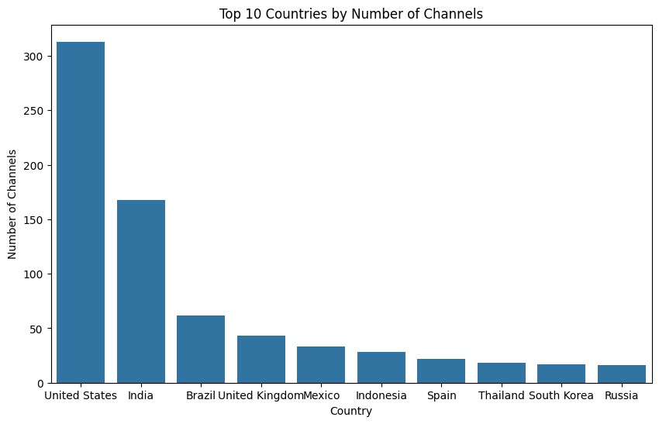
Country-wise Analysis
The United States contributes the highest number of YouTube channels.
India comes in second with around 170 channels, showing it’s become a major hub for content creators.
After that, things drop off fast, Brazil, UK, Mexico each have somewhere between 40-60 channels and the rest of the list trails even further behind with channel counts under 30.
Interpretation
Regional internet penetration, population scale, and digital consumption patterns significantly influence creator ecosystem development.

Slide 12
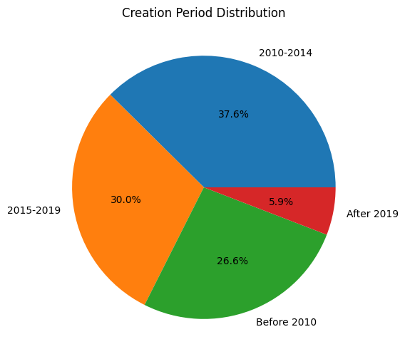
Distribution of Channel Creation Periods
More than 94.2% of leading channels were established before 2019.
Only a small proportion of top channels were created after 2019.
The distribution suggests that many successful creators have built their audiences over an extended period.
Interpretation
The analysis indicates that sustained platform presence and long-term audience building are common characteristics of the most successful YouTube channels.

Slide 13
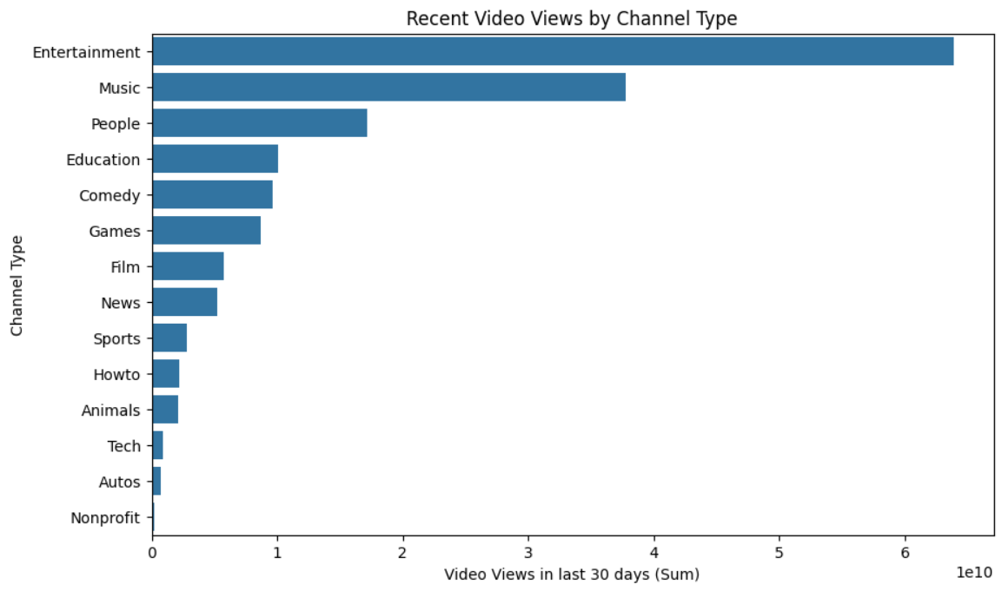
Recent Viewership by Channel Type
Entertainment channels generated approximately 64 billion views in the last 30 days, nearly twice that of Music channels
Music channels generated approximately 38 billion recent views.
Audience attention is concentrated within a few content categories, with a sharp decline beyond the top performers.
Technology, automotive, and nonprofit channels record the lowest recent viewership levels.
Interpretation
Recent engagement patterns indicate a strong audience preference for entertainment-focused content on YouTube.

Slide 14
Major Findings from the Analysis
Entertainment and music channels dominate global audience engagement
Subscriber growth strongly influences monetization capability
Audience reach demonstrates stronger impact than upload frequency
The United States and India lead the creator ecosystem globally
High-engagement content significantly improves visibility and platform growth

Slide 15
Business Recommendations
Recommendations for Content Creators
Optimize for view-through, not output volume. Since uploads barely correlate with subscriber or view growth (slide 8), creators and brands should shift budget from "post more" to "make each post retain longer" — e.g., better hooks, pacing, thumbnails.
Weight category strategy toward entertainment-adjacent formats. Entertainment videos pulled ~64B recent views versus music's ~38B (slide 13) — categories outside these two (tech, automotive, nonprofit) see materially lower reach, so niche categories should focus on cross-pollinating with entertainment style rather than competing head-on for volume.Focus on highly engaging content categories with strong audience retention.

Slide 16
Data Analytics Skills
Data Cleaning & Preprocessing
Exploratory Data Analysis
Statistical Interpretation
Correlation Analysis
Data Visualization
Insight Generation
Python Libraries Utilized
Pandas
NumPy
Matplotlib
Seaborn

Slide 17
Conclusion
This analysis successfully identified major trends within the global YouTube creator ecosystem through data-driven exploration and visualization.
The project highlighted:
audience engagement dynamics
creator growth patterns
category-based performance trends
long-term channel growth characteristics
The findings demonstrate how analytical techniques can be used to extract meaningful insights from large-scale digital platform data.

